Slide 1
Towards a System of Population and Social Accounts: Building on past and current practices in social accounting, statistics and indicators
Ivo Havinga, Consultant
United Nations Network of Economic Statisticians
Informal Network meeting, Brussels, 9 November 2022

Slide 2
Integrated statistical system for inclusive and sustainable wellbeing:
a snapshot
Accounts, statistics and indicators
Central Framework
System of Population and Social Accounts (SPSA)
System of Environmental-Economic Accounting (SEEA)
System of National Accounts (SNA)
Colour-coding:
Green – System essentially exists
Amber – Significant components already exist and can be integrated without interrupting current statistical delivery
Accounts, statistics and indicators
Accounts, statistics and indicators
Accounts, statistics and indicators

Slide 3
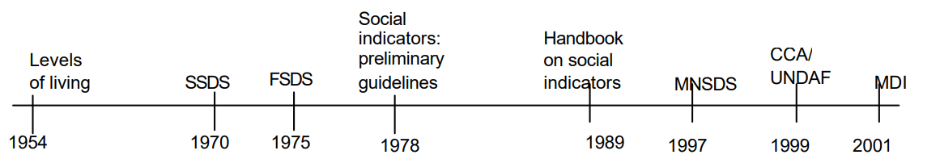
Efforts towards a systematic development of social accounting, statistics and indicators
Timeline - overview of the Statistical Commission initiatives
+SDG
2015
SSDS = System of Social and Demographic Statistics FSDS = Framework of Social and Demographic Statistics MNSDS = Minimum National Social Data Set CCA/UNDAF = Common Country Assessment /United Nations Development Assistance Framework MDI = Millennium Development indicators SDG = Sustainable Development Goals
United Nations Expert Group Meeting on the Scope and Content of Social Statistics 9-12 September 2008 United Nations, New York, ESA/STAT/AC.161/1

Slide 4
Efforts towards a systematic development of social accounting, statistics and indicators
1954 International definition and measurement of standards and levels of living
“component approach”, aimed at measuring levels of living through a series of twelve components - physical wellbeing, related material elements such as consumption, as well as “non-material” factors such as the satisfaction of cultural or educational needs, etc.
1970 System of Social and Demographic Statistics, released in 1975 (main author Sir Richard Stone, also the author of the System of National Accounts
an attempt to establish, in the demographic area, a system complementing the system of national accounts
desirability of establishing a closer relationship between social and economic statistics, particularly those relative to the system of national accounts

Slide 5
Efforts towards a systematic development of social accounting, statistics and indicators
System of Social and Demographic Statistics:
link stocks and flows of individuals and groups of individuals to economic information and in particular the provision of services.
information on individuals organized in matrices
economic information (e.g., the distribution of income, consumption and accumulation/wealth) organized as an extension of the System of National Accounts
time accounts included
regional and geographical information included
consistent classifications, definitions and concepts realized
record linkages advocated
longitudinal data advocated

Slide 6
System of Social and Demographic Statistics
Efforts towards a systematic development of social accounting, statistics and indicators
System of Social and Demographic Statistics (SSDS) – 11 sub-systems – ready to be represented in accounts – and done since by specialized UN agencies (e.g., ILO, UNWHO, UNESCO)
The size and structure of the population, births, deaths and migration
Family formation, families and households
Social class stratification and mobility
Distribution of income, consumption, accumulation and net worth
Housing and the environment
Allocation of time and the use of leisure
Social security and welfare services
Learning activities and educational services
Earning activities, employment services and the inactive
Health and health services
Public order and safety, offenders and their victims

Slide 7
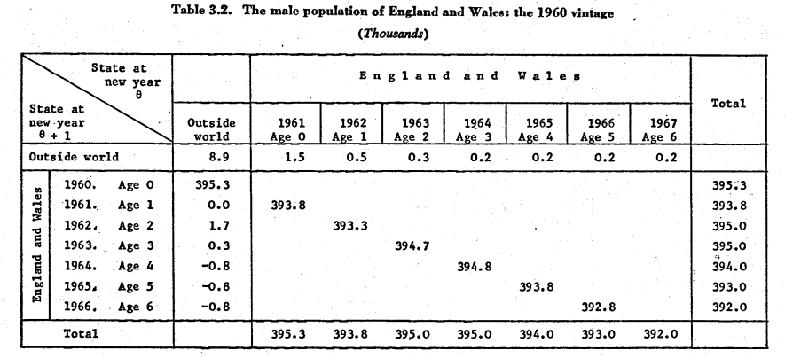
System of Social and Demographic Statistics
Efforts towards a systematic development of social accounting, statistics and indicators: example population stock and flow

Slide 8
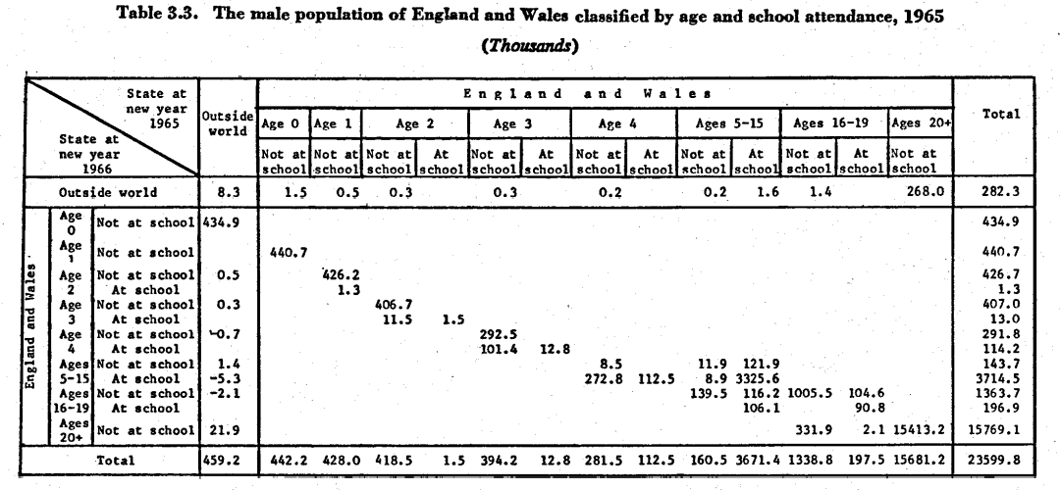
System of Social and Demographic Statistics
Efforts towards a systematic development of social accounting, statistics and indicators: : example population stock and flow by educational detail

Slide 9

Further disaggregation of population stock and flows measuring population change -> Inclusive and Sustainable Development
Population age structure is changing rapidly around the world
Many economic activities vary by age and gender, and these age and gender differences are changing, too.
consumption, labor earnings, savings, unpaid care work, use of health care and education services, etc.
These changes have important implications for:
Economic growth;
Sustainability of systems of financial support from the family, the state, and financial markets.
Inequality by age, gender, socioeconomic group, and generation.
p(x,t)
s(x,t)
S(t) = s(x,t)*p(x,t)

Slide 10

Deriving National Transfer Accounts (NTA) from SNA for consistency between socio-demographic statistics and national accounts
$${C+S= Y}^{l}+Y^{k}+Y^{p}+τ$$
Consumption + Savings = Primary Income + Transfers
$${C\left(x\right)+S\left(x\right)= Y}^{l}\left(x\right)+Y^{k}\left(x\right)+Y^{p}\left(x\right)+τ\left(x\right)$$
Disaggregate by age
${C\left(x\right) −Y}^{l}\left(x\right)={[Y}^{k}\left(x\right)+Y^{p}\left(x\right)−S]+τ^{g}\left(x\right)+$ $τ^{f}\left(x\right)$
Life cycle deficit = Asset-based reallocations + Public Transfers + Private Transfers

Slide 11
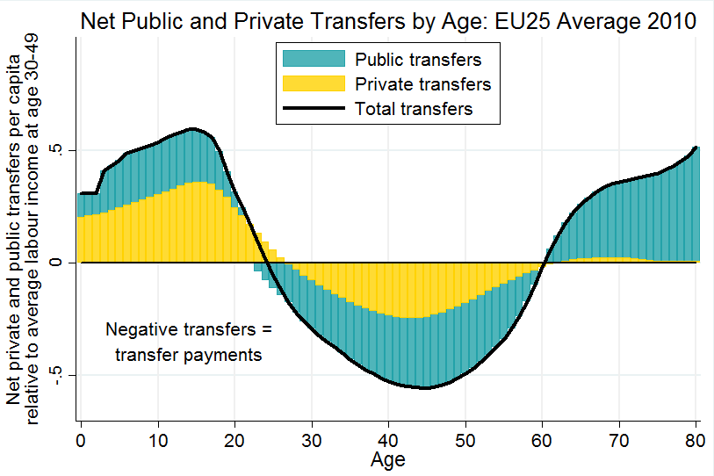

Net public transfers (benefits less taxes) and private transfers in Europe.
www.agenta-project.eu

Slide 12
Efforts towards a systematic development of social accounting, statistics and indicators
FSDS – “Improving social statistics in developing countries: conceptual framework and methods, released in 1979
outlined a conceptual framework setting the scope and desirable priority areas of an integrated framework – a SSDS-light for developing countries
structure and coherence distinguished a framework from a disjointed list of statistical series is structure and coherence.
use of consistent classifications and definitions throughout the entire body of statistics
development of suitable aggregates

Slide 13
Efforts towards a systematic development of social accounting, statistics and indicators
In 1985 the debate
whether work on an overall system should be considered an essential element of the work on social indicators
to develop an overall system and systematize social and related statistics and indicators being an essential element in the work on social indicators.
whether social indicators should be developed for specific purposes without reference to a fixed general framework
To develop social indicators for specific purposes –for example, concerning special population groups or policy concerns –could be developed from underlying basic statistics without reference to a fixed general framework.
Outcome
Progress on social statistics and indicators for special population groups (women. persons with disabilities, youth, migrants, older persons, children, etc.) and specific themes (education, health, culture, governance, poverty, etc.)
Important role for Population and housing census programs supported by the Principles and Recommendations for Population and Housing Censuses – 2008 Revision 2 and 2017 Revision 3

Slide 14
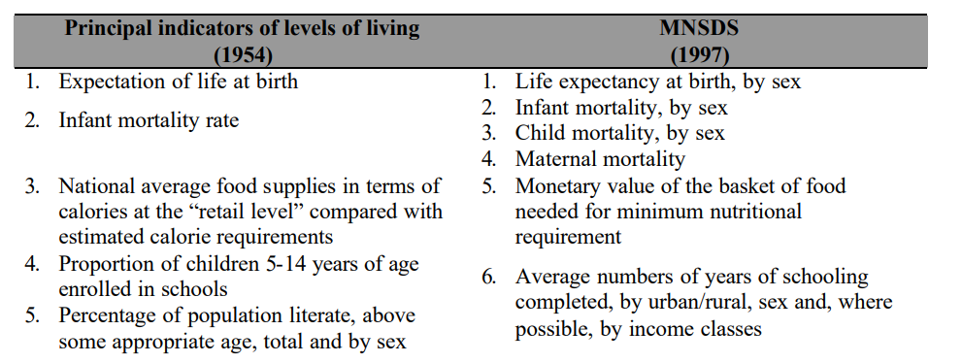
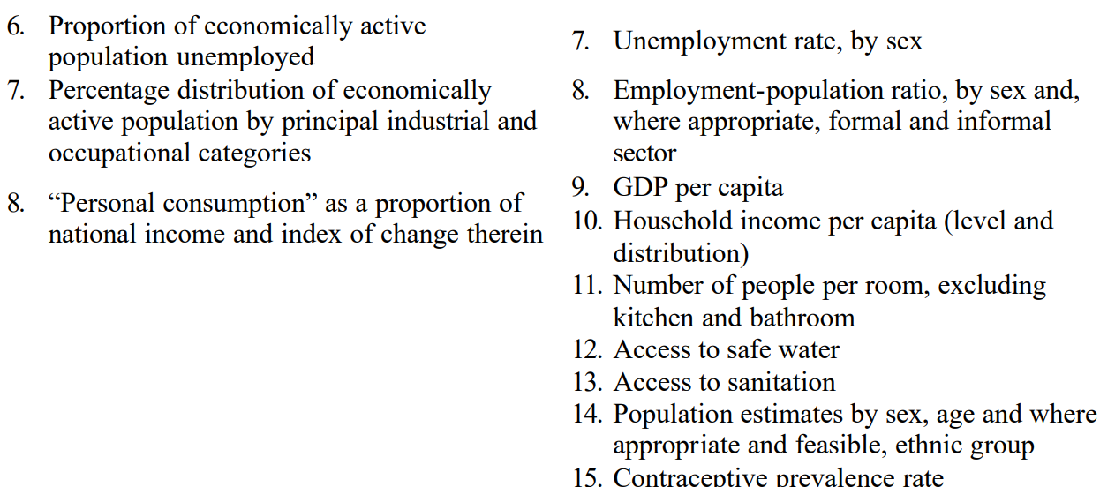

Slide 15
Why accounting? example for labour market accounts
Contradictory results between data sources (establishment and household surveys, registers, population statistics (gross flows- birth, death, emigration, immigration)
Fragmented approach leads to overlaps and gaps and lacks comprehensive use the labour market data
Difficulties and limitations in describing labour market dynamics and connections
Links between labour market data and other statistical systems are missing– national accounts, and population or education statistics.
ILO definition of labour accounts: "provide a logical framework for obtaining internally consistent estimates of key labour market variables and their distribution over the population ..(which) .. are necessary for the description and analysis of the state and dynamics of the labour market and its interaction with the rest of the economy“
Reference - Labour Accounts: A Step Forward to a Coherent and Timely Description of the Labour Market- 2002 - Brigitte Buhmann, Wim Leunis , Alain Vuille and Kirsten Wismer

Slide 16
Why accounting? example for labour market accounts
Steps to be taken:
Defining of accounting identity equations
Jobs = employed persons - employed persons on leave + secondary jobs
Total hours worked = number of jobs * actual hours per job
Total compensation = number of jobs * compensation per job
Harmonizing definitions and classifications in source statistics
Identifying measurement errors
Balancing

Slide 17
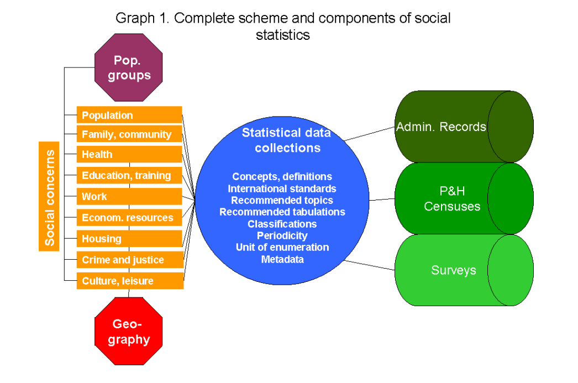
System of Population and Social Accounts
Source: United Nations Expert Group Meeting on the Scope and Content of Social Statistics 9-12 September 2008 United Nations, New York, ESA/STAT/AC.161/1

